Slide 1
Monitoring, Logging, and Code Analysis

Slide 2
What is static analysis?
Static analysis is a method of analyzing code for defects, bugs, or security issues prior to pushing to production.
Often referred to as “linters,” static analysis tools remove the unnecessary fluff from your code and perform some automated checks to improve code quality.

Slide 3
What is static analysis?
Static analysis tools can check for:
Inconsistencies in code style conventions and standards. It can be as simple as enforcing consistent indentation and variable names or as complex as enforcing compliance with the MISRA or CERT Secure Coding Standards.
Resource leaks such as a failure to release allocated memory, which can eventually lead to program crashes or failure to close files
Incorrect usage of Application Programming Interfaces (APIs)
Common security vulnerabilities such as those identified by the Open Web Application Security Project (OWASP) or Common Weakness Enumeration (CWE)

Slide 4
Static Analysis Tools
The static analysis tools available can be categorized by the capabilities they support, including:
Programming languages: Tools may support single or multiple languages. If your codebase spans multiple languages, a single tool like Coverity which supports 14 languages including JavaScript, .NET, Java, and Python may be the most thorough option for discovering bugs across languages.
Real-time tools: Instantaneous analysis tools are ideal for checking code in development environments as it’s being written. Here, the tradeoff is speed over more thorough, time-consuming checks. Many of these are open source, which allows for easier adoption and customization.

Slide 5
Static Analysis Tools
The static analysis tools available can be categorized by the capabilities they support, including:
Deep analysis tools: On the other end of the spectrum, deep analysis tools can take much longer and are likely to identify issues that a real-time tool would miss. Enterprise-grade tools in this area often have hefty licensing fees and they may bring more issues to light than you have the bandwidth to address. Many of these tools may be configured to report only the most important issues,.
Compilers: Although not a dedicated static analysis tool, compilers may also be used to improve the quality of your code. You can use configuration flags to adjust the number of checks they perform.

Slide 6
Integrating Static Analysis within CI/CD
Among the many benefits of using static analysis tools, the one that is most beneficial to organizations is the ability to discover bugs before they are released into the wild (and when they are less costly to fix).
Within the DevOps practice of CI/CD, static analysis tools provide additional benefits.
Tools that take a long time to run tend to be ignored during development.
Even if static analysis isn’t always a long process, it’s still not the best use of a developer’s time.
Integrating analysis tools within CI/CD ensures that they are used consistently and automatically while offering an extra level of analysis to make sure that nothing is able to sneak through.

Slide 7
Integrating Static Analysis within CI/CD
There are different options for how to integrate static analysis tools in your environment.
One approach is to run it early in the pipeline along with other automated tests.
At this point, you’ll be able to fix any issues before the peer code review and it speeds up the overall process.
In turn, developers spend less time reviewing and have more time to develop new code.
If you have large code bases, running a deep analysis on every commit may take too much time.
Instead, you can use a less thorough analysis configuration on development branches and perform more expensive scans on a schedule or when integrating into upstream branches.
The goal is to discover bugs as early as practically possible and it’s up to you to choose the system that works best for your team.

Slide 8
Integrating Static Analysis within CI/CD
Higher-end static analysis tools can also track bugs over time.
This can help you select which issues to work on in the current release cycle as source code is continuously being integrated.
Issues reported in longstanding legacy code that haven’t caused problems are probably not worth the time investment to resolve them in the immediate term.
Instead, use precious developer time to focus on more recent issues.
Another practical constraint is the budget available for static analysis.
Rather than obtaining a license for each developer, run the analysis tools on a set number of build machines (or a single machine if possible).

Slide 9
DevOps: Monitoring and Logging

Slide 10
Why Monitoring and Logging are Essential
DevOps monitoring and logging are essential for several reasons.
Monitoring and Logging provide real-time visibility into system health, enabling teams to identify and address issues promptly.
By continuously monitoring key metrics such as response times, CPU and memory utilization, and error rates, teams gain a comprehensive understanding of system behavior and can proactively detect and resolve potential bottlenecks or failures.
Monitoring and logging also help in capacity planning and resource optimization by identifying performance trends and forecasting future requirements.

Slide 11
Why Monitoring and Logging are Essential
Monitoring and logging enable effective troubleshooting.
When issues arise, detailed logs and metrics aid in pinpointing the root cause, reducing mean time to resolution (MTTR).
Logs serve as a valuable source of information, capturing system events, errors, and user activities.
They can be used to trace transactions, reconstruct events leading to failures, and provide valuable context during post-mortem analysis.
Monitoring and Logging contribute to data-driven decision-making and continuous improvement.
By analyzing historical data and trends, teams can identify areas for optimization, enhance system performance, and make informed decisions regarding capacity scaling, feature prioritization, and infrastructure upgrades.

Slide 12
Integration into the DevOps Workflow
Monitoring and logging are seamlessly integrated into the DevOps workflow, ensuring continuous feedback and facilitating the cycle of continuous integration, delivery, and deployment. Let’s examine their placement within the typical DevOps flow:
Development: Developers instrument their code with appropriate logging statements to capture relevant information during runtime. These logs can help track application behavior, identify code issues, and enable efficient debugging during the development phase.
Continuous Integration (CI): Monitoring and logging tools can be integrated into the CI process to capture build and test metrics, providing visibility into code quality and identifying potential integration issues.

Slide 13
Integration into the DevOps Workflow
Continuous Delivery (CD): Monitoring and logging play a vital role during CD by capturing application performance and infrastructure health metrics in pre-production and production environments. They help verify the successful deployment of new features or changes and ensure the system is functioning as expected.
Production Environment: In the live production environment, monitoring tools continuously collect metrics on system health, response times, resource utilization, and more. Alerts and notifications can be configured to notify the appropriate teams in case of anomalies or critical incidents.

Slide 14
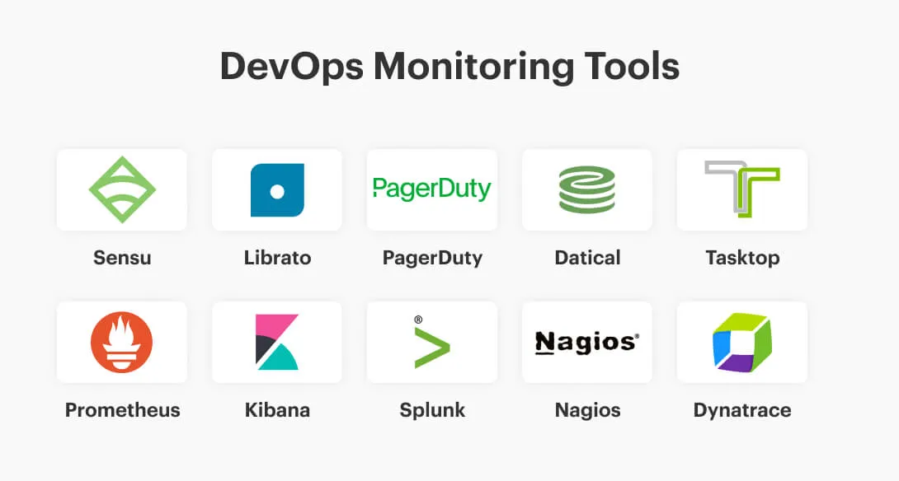
Popular Tools for Monitoring and Logging

